Slide 1
Decimalization and the ETFs and Futures Pricing Efficiency
Wei-Peng Chen*, Robin K. Chou** and Huimin Chung*
*Department of Finance, Shih-Hsin U.
**Department of Finance, NCU
***Graduate Institute of Finance, NCTU
August 24, 2007

Slide 2
Background Information
Definition
  Tick size is the minimum price variation allowed for quoting and trading in financial assets, and refers to the smallest amount by which a trader may improve a price.
June 24, 1997
  one eighth ($0.125) → one sixteenth ($0.0625)
January 29, 2001
  one sixteenth ($0.0625) → decimalization ($0.01)

Slide 3
Benefits of Decimalization
The reduction in tick size would improve market liquidity. (Bollen and Whaley, 1998; Ronen and Weaver, 2001; Henker and Martens, 2005)
  A smaller tick size would benefit liquidity demanders as competition between liquidity providers increases.
  This would induce a reduction in overall bid-ask spreads.

Slide 4
Benefits of Decimalization
Traders are enjoying reductions in their average execution costs. (Bessembinder, 2003)
Actively-traded stocks generally experience an increase in liquidity. (Furfine, 2003)
Decimal pricing increased the value of private information and raised the informational efficiency of asset price. (Zhao and Chung, 2006)

Slide 5
The Viewpoint of Opponents
The reduction in tick size may have benefit certain liquidity demanders, this is to the detriment of liquidity providers. (Harris, 1994; Glodstein and Kavajecz, 2000; Jones and Lipson, 2001; Bollen and Busse, 2006)
  The increase in the costs of providing liquidity would lead to a decline in their willingness to provide liquidity.
The market liquidity is decided by changes of bid-ask spread and quoted depth.
  Decimalization does not only lead to smaller spreads, but also cause a fall of depth.

Slide 6
The Viewpoint of Opponents (Contd.)
Decimalization has no effects on the trading costs for large trades. (Graham, 2003)
The influence of penny pricing on trading costs is unclear for institutional investors. (Chakravarty et al., 2004)
Actively-managed mutual funds experience an increase in trading costs after decimalization. (Bollen and Busse, 2006)

Slide 7
Literature Review
Arbitrage activities may be affected by liquidity.
  The required positions taken by arbitrageurs are usually large (a deep market). (Kumar and Seppi, 1994)
  Market liquidity enhances the efficiency of the futures/cash pricing system. (Roll et al., 2005)
  Chakravarty et al. (2005)
    Decimalization appears to have benefited those institutions with greater patience, whereas it may have hurt those seeking quick execution of trades.

Slide 8
Literature Review
Why arbitrageurs profits may have suffered as a result of decimalization:
  Arbitrageurs require a deep market when engaging in arbitrage activities. (Anshuman and Kalay, 1998)
  The execution risk would likely rise due to the reductions in average execution speed. (Harris, 1991)
  A reduction in tick size may weaken the priority rules in the limit order book. (Harris, 1994, 1996; Angel, 1997; Seppi, 1997)

Slide 9
Hypothesis Development
Arbitrageurs face higher execution risk because of decreased quoted depth and slower execution speed after decimalization.
The pricing efficiency on average may have deteriorated in the post-decimalization period.
  Arbitragers will participated in trading only when it is profitable to do so, meaning that only when the mispricing signal is large enough to compensate for the increased execution risk.

Slide 10
The Related Studies
Henker and Martens (2005) study the spot-futures arbitrage during the pre- and post-introduction of sixteenths on the NYSE.
  Their focus is on the examination of the size of the theoretical mispricing signals.
Chou and Chung (2006) examine the pre- and post-decimalization transmission of information between ETFs and index futures.
  They provide no evidence on the ways in which decimalization may have affected pricing efficiency from the perspective of arbitrage opportunities.

Slide 11
Niches of Research
This study differs from the extant literature in the following ways:
  The influences of penny pricing on pricing efficiency across closely related markets are analyzed.
  This study explicitly considers transaction costs while also measuring the profits from ex-ante arbitrage trading.
  The pricing efficiency of the entire distribution of mispricing sizes is analyzed by the quantile regression.

Slide 12
The Data
Period
  Pre-Decimalization: July 27, 2000~January 28, 2001
  Post-Decimalization: January 29, 2001~July 30, 2001
Subjects
  S&P 500 Index: SPDR and ES
  NASDAQ 100 Index: QQQ (now QQQQ) and NQ

Slide 13
Sources of the Data
Quote and trade data on ETFs
  NYSE’s Trade and Quote (TAQ) database
Traded data on E-mini futures
  TickData Inc. Database
The dividend data of ETFs
  CRSP daily database
The risk-free rate
  The three-month T-Bill rates

Slide 14

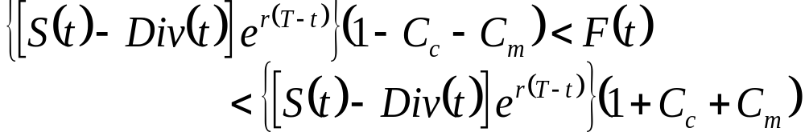


Theoretical Model
Cost-of-carry model
To account for transaction costs, the no-arbitrage band for the futures price
  and represent commissions and market impact costs, respectively.

Slide 15
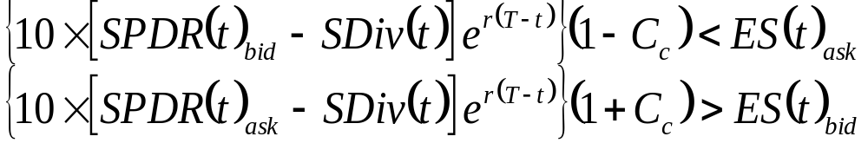
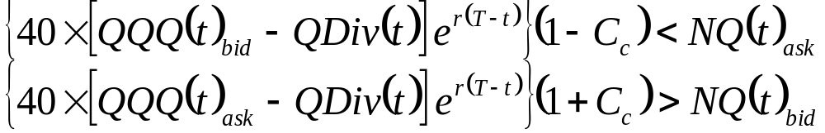
Ex-Post Analyses
The bid and ask prices are used to gauge the market impact costs, the no-arbitrage band
  between SPDRs and S&P 500 E-minis
  between QQQs and NASDAQ 100 E-minis

Slide 16
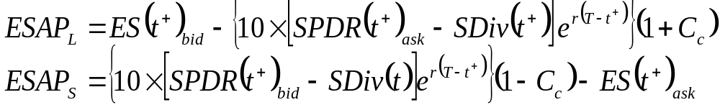
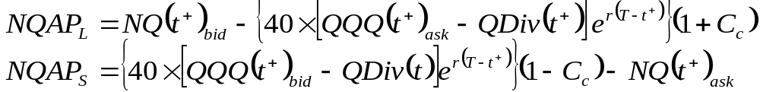
Ex-Ante Analyses
Arbitrageurs can trade at the next available ETF quote and futures trade prices immediately after observing a mispricing signal, the ex-ante profits of long and short arbitrage trades
  between SPDRs and S&P 500 E-minis
  between QQQs and NASDAQ 100 E-minis

Slide 17
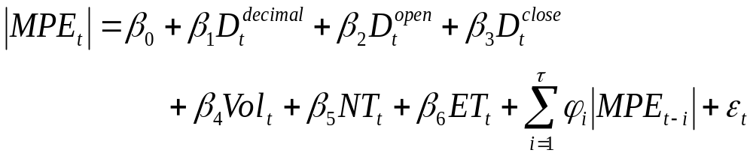





Regression Analyses
The changes in pricing efficiency can be affected by the changes in general market factors. (Chung, 1991; Kurov and Lasser, 2002)
Regression Model (Kurov and Lasser, 2002)
  : average absolute mispricing errors
  : dummy variables
  : ETF volatility
  : number of ETFs trades
  : time to expiration of the E-minis

Slide 18
Reasons for the Use of Quantile Regression
The OLS method would only show the change in mispricing on average.
The quantile regression method could show the change in mispricing under various quantiles.
  The results from different quantile regressions provide a more complete description of the underlying conditional distribution of pricing errors.

Slide 19
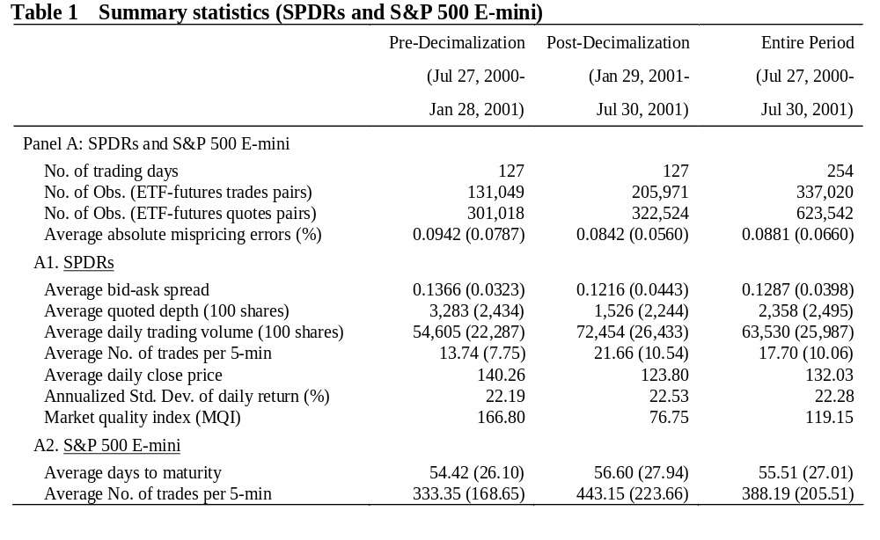
Summary Statistics

Slide 20
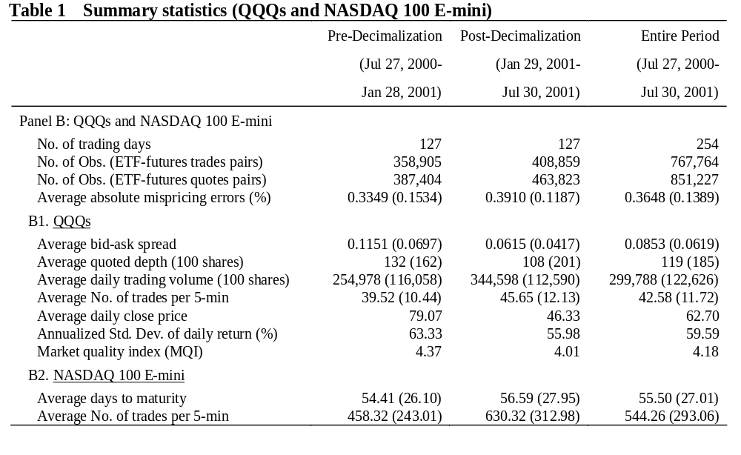
Summary Statistics

Slide 21
Table 1 reports the summary statistics, including quote depth, close price, trading volume, number of trades, days to maturity, bid-ask spread, market quality index, pricing error, and volatility.
As expected, after decimalization, there are decreases in bid-ask spreads and quoted depth, and there is an increase in the average daily trading volume for SPDRs and QQQs.
This result is consistent with those found in the prior studies (for example, Gibson et al., 2003; Chou and Chung, 2006). As argued above, a smaller spread size may not necessarily be advantageous to arbitragers, who are likely to act as providers or porters of liquidity in the market.

Slide 22
Previous studies on equity securities have demonstrated that there is a general reduction in the quoted depth after decimalization, and we also find this to be the case for both SPDRs and QQQs.
Such reduction in market depth is likely to harm arbitrageurs, who usually trade large positions in order to realize the arbitrage profits.
Even though the average quoted depth for both ETFs seem to be large, the standard deviation of quoted depth indicates that the quoted depth is quite volatile. Thus, it is very likely that arbitragers will experience times when the market depth is low and thus face high execution risk. This prompts us to empirically examine the arbitrage opportunity between ETFs and E-mini futures.

Slide 23
We find decrease (increase) in the average absolute mispricing errors for QQQs (SPDRs) after decimalization.
No definite conclusions can be made regarding the cash/futures pricing efficiency after decimalization, which might be caused by failing to control for changes in other market factors, an issue will be addressed later by the OLS and quantile regressions.
We further gauge the overall market quality by adopting a market quality index (MQI) similar to that proposed by Bollen and Whaley (1998). We define MQI in this study as the ratio between the half quoted depth of the prevailing bid-ask quotes and the percentage quoted spread.

Slide 24
We report the results of the ex-ante analyses under the assumption that arbitragers can only transact at the next available futures trade price and ETF quote price after observing a mispricing signal.
Table 2 and Table 3 present the results for SPDRs and QQQs surrounding decimalization, respectively.
As Table 2 shows, under different levels of transaction costs, there are significant decreases in the number and percentage of profitable trades for SPDRs after decimalization.
Table 3, on the contrary, shows substantial increases in the number and percentage of profitable trades for QQQs after decimalization.

Slide 25
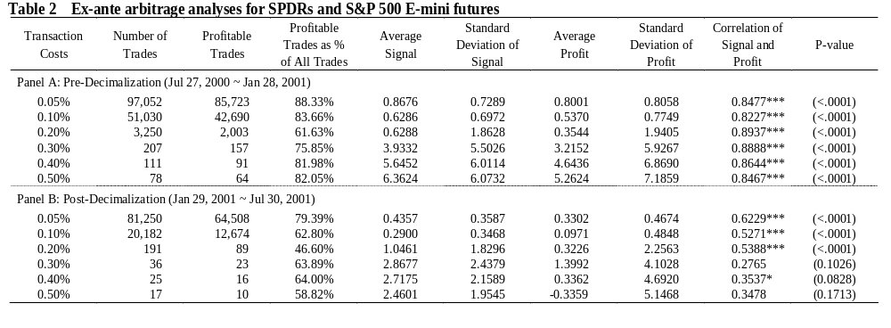
Ex-Ante Arbitrage Profit Analyses

Slide 26
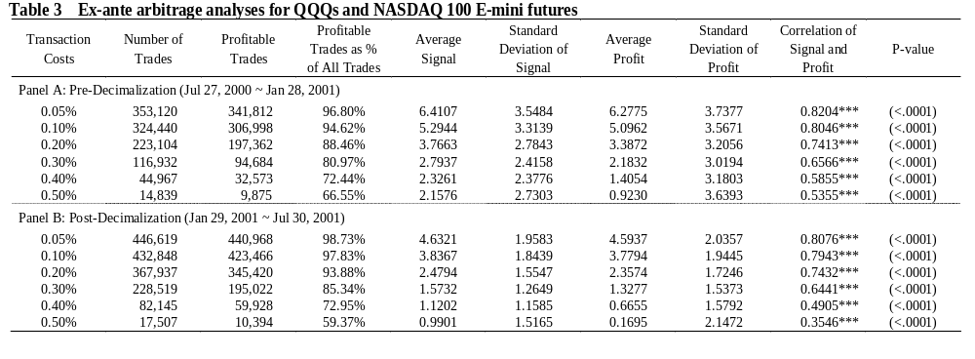
Ex-Ante Arbitrage Profit Analyses

Slide 27
As demonstrated in Table 4 and Table 5, the positively significant OLS coefficients of decimal dummy indicate higher pricing errors after decimalization and imply that the pricing efficiency of the cash/futures system has become significantly worse on average after decimalization, after controlling for changes in other market factors.
We next perform the quantile regression to analyze the entire distribution of mispricing size in the post-decimalization period.
Quantile methods provide support for our argument in that the coefficients on decimal dummy in the pooled quantile regressions became negative for quantiles greater than 65% for SPDRs and 85% for QQQs.
The coefficients further become significantly negative for quantiles over 70% and 85% for SPDRs and QQQs, respectively.

Slide 28
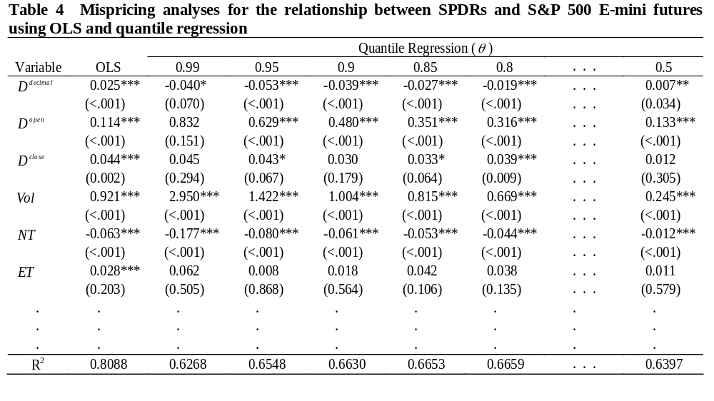
Regression Analyses of Mispricing

Slide 29
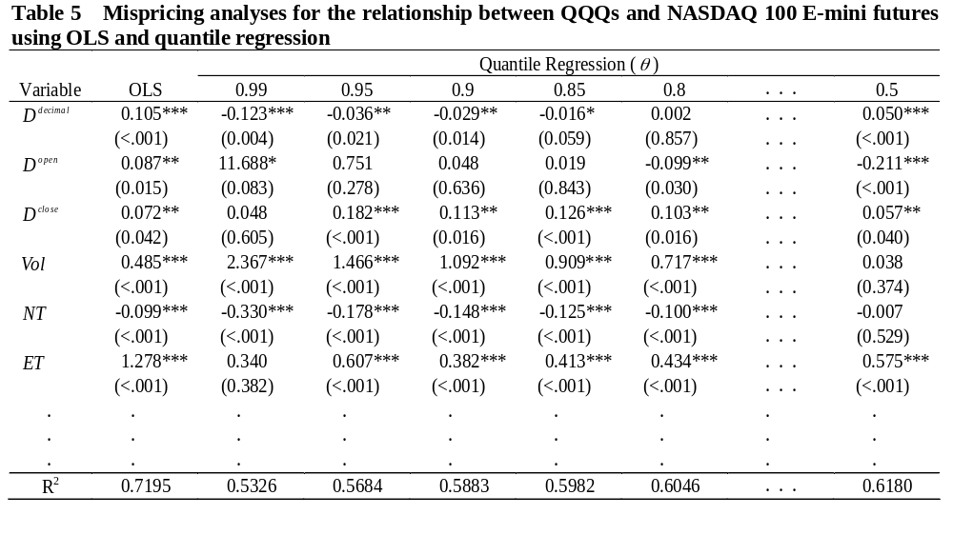
Regression Analyses of Mispricing

Slide 30
Conclusions
Penny pricing has led to
  a reduction in the willingness of arbitrageurs to engage trading;
  lower pricing efficiency on average; and
  the improvement in pricing efficiency only occur in large mispricing size.
Decimalization is likely to reduce the feasibility of arbitrage trades, due to
  the reduction in profitable market depth; and
  the increase in execution risk.
These findings are consistent with the results of Chakravarty et al. (2005)
  Institutional traders seeking quick executions may have been hurt by penny pricing.

